Slide 1
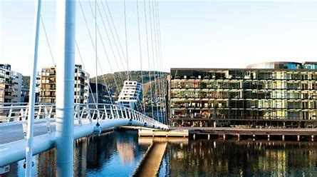
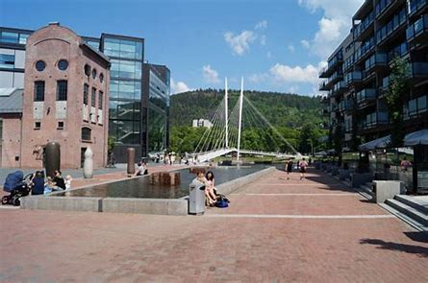
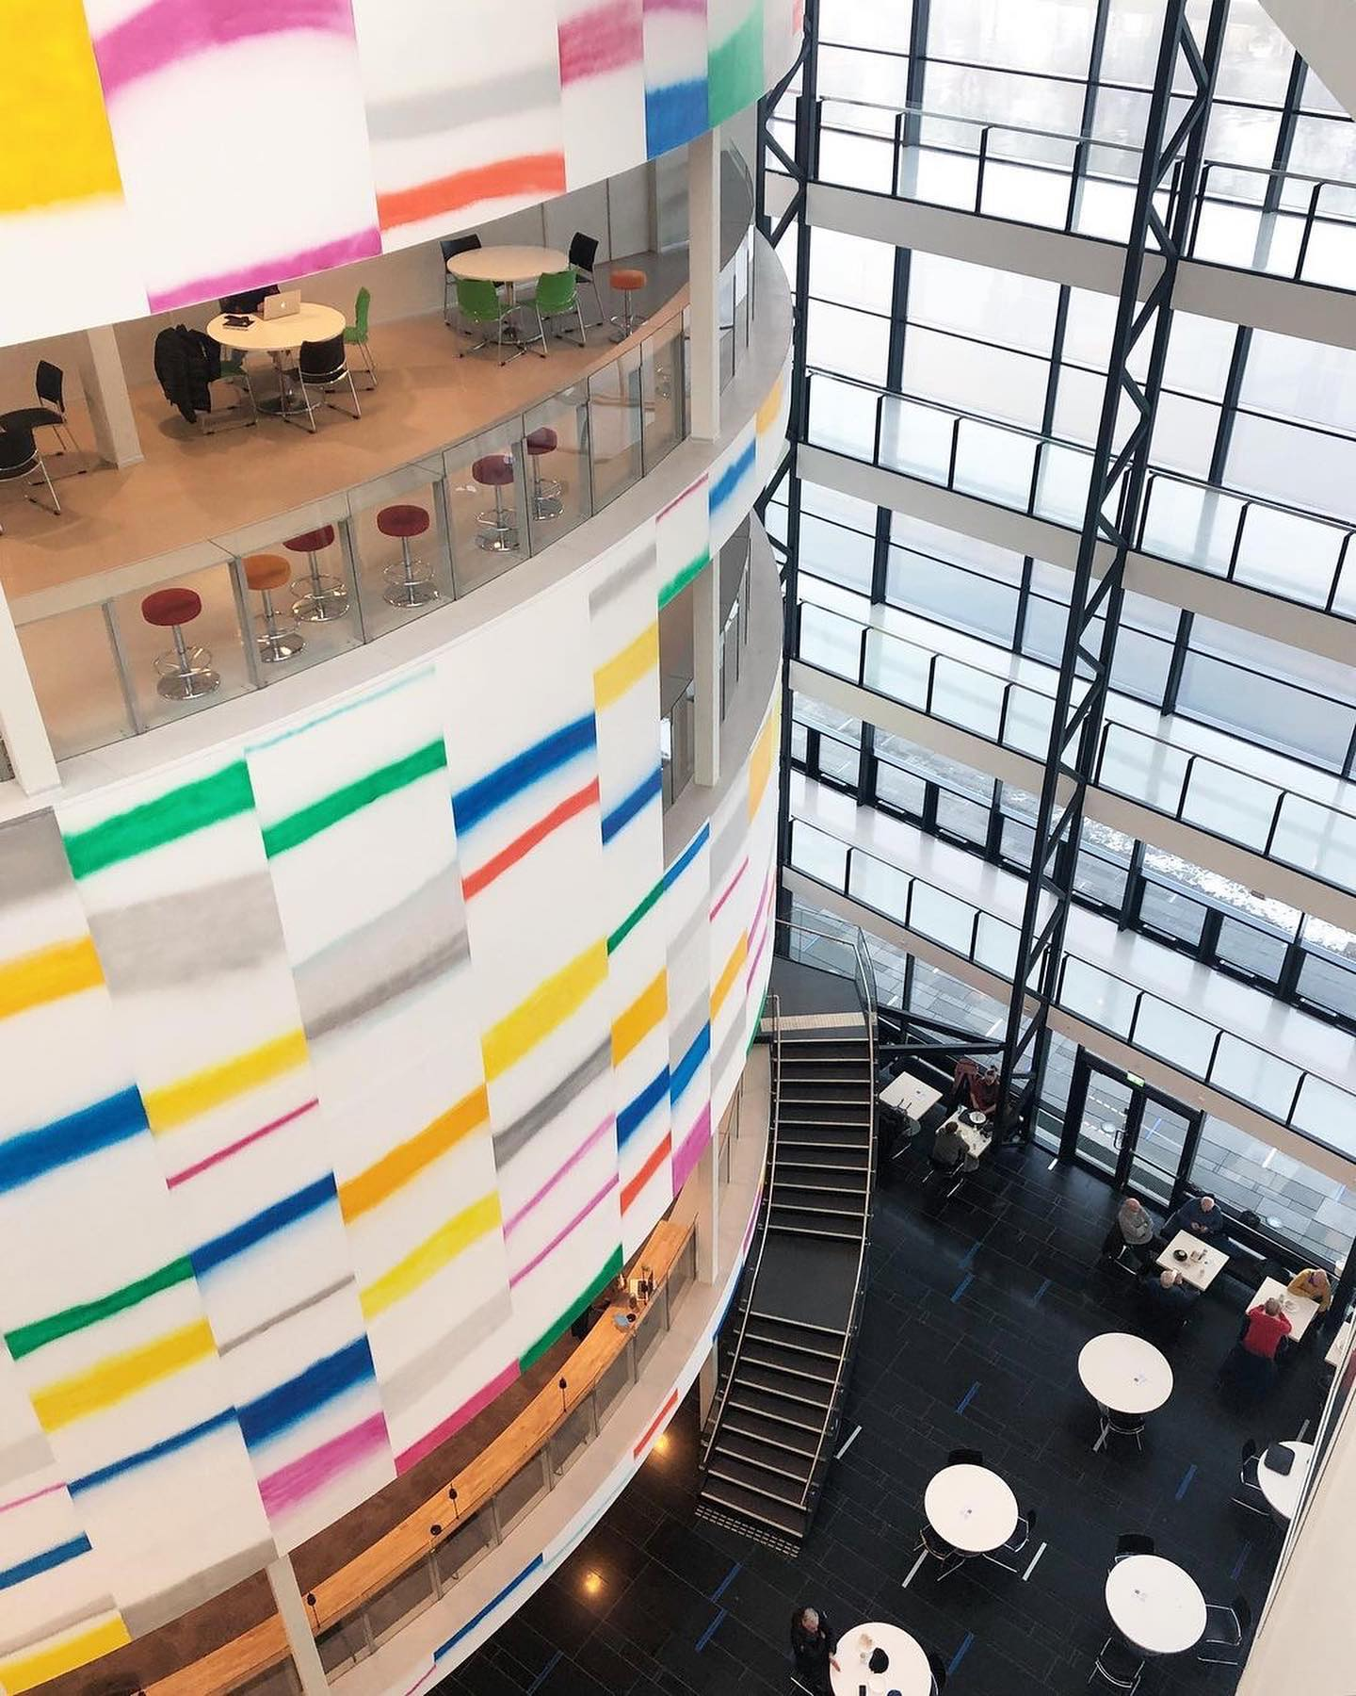

Slide 2
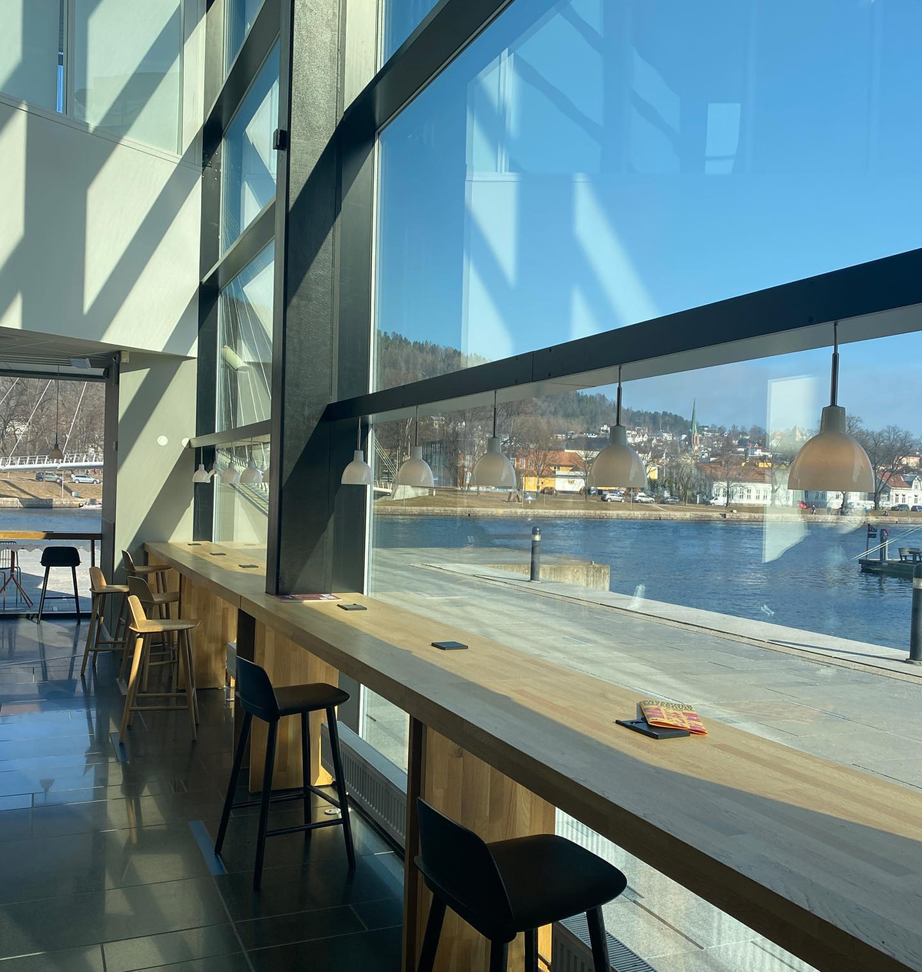
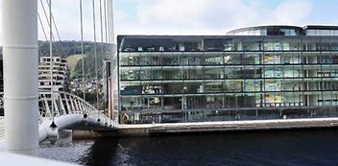

Slide 3
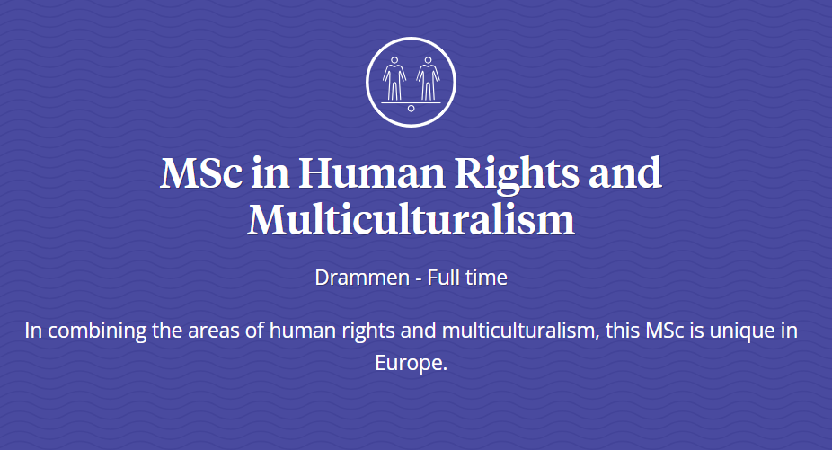

Slide 4
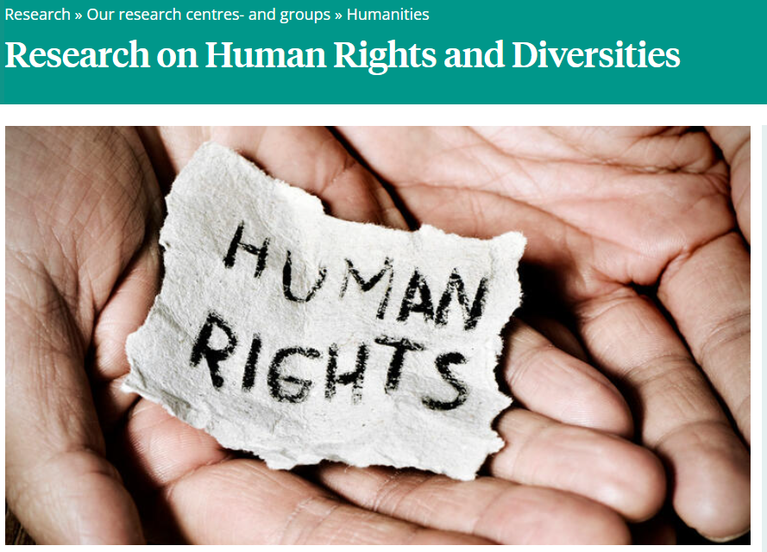
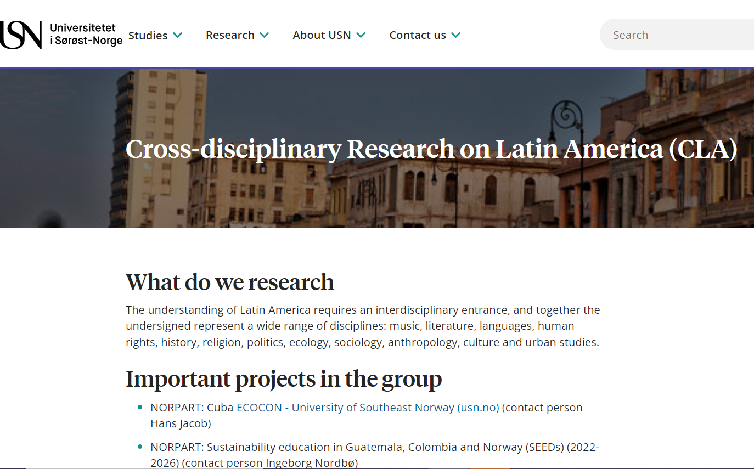
Human Rights and Diversities - Universitetet i Sørøst-Norge (usn.no)
Cross-disciplinary Research on Latin America (CLA) - University of Southeast Norway (usn.no)

Slide 5
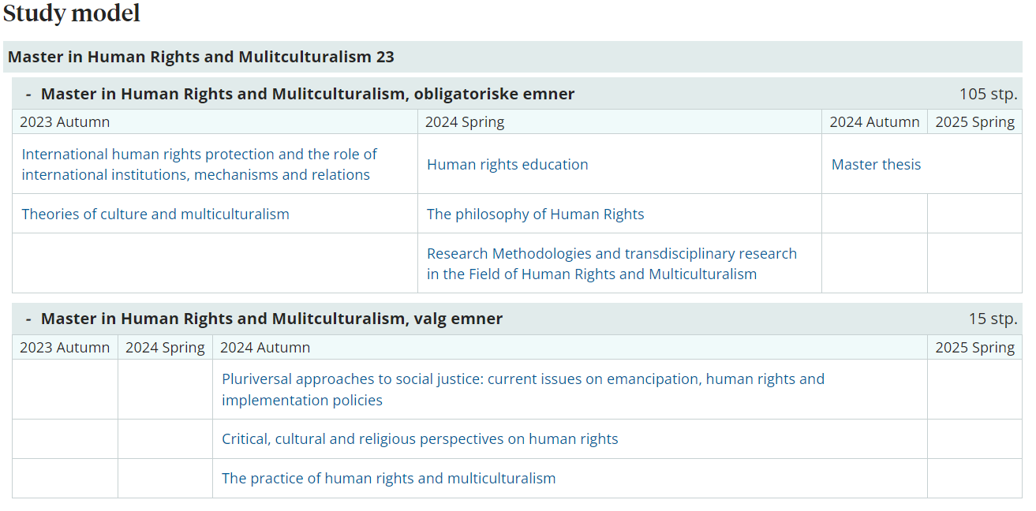

Slide 6
MHRMC – Theses - June 2023
1) The role of refugee and migrant-led organizations in Greece: A critical analysis based on migrants’ and refugees’ perceptions on integration and participatory parity. Eleni Kelaraki
2)Migration, technology, and control: A critical discourse analysis concerning data gathering and information sharing of third-country nationals. Vilde B. Winge
3) Towards Pluriversal Approaches to Rights of Nature and the Human Right to a Healthy Environment? A Critical Discourse Analysis of Selected Judicial Decisions from Ecuador, Kenya and India. Piyumani Panchali Ranasinghe Arachchige
4) Resistance, Navigations and Negotiations A decolonial reading of narratives and counter-narratives from Norwegian Roma and Romani.. Vilde Hoel Martinsen
5) Power Imbalances in the Use of Technology Combating Forced Labour in the Context of Trafficking in Human Beings in the European Union: A Critical Discourse Analysis. Eliane Janine
6) Identity, Belonging and Political Activism: A Study on Young Adults Among the Kurdish Diaspora in Norway. Tania Jonaid Saleh

Slide 7
7) The Role of Information and Communication Technologies in Sexual Exploitation. Perspectives of Professionals Working in Italian Anti-Trafficking Organisations. Federica Malconi
8) Understanding Conflict-Related Sexual Violence: A Comparative Analysis of FARC and PKK`s Repertoires of Violence. Mari Rolfsdatter Aspen.
9) Child Labor in the Waste Industry in Tehran: Human Rights Violations, Vulnerability, and the Precarious Lives of Children in Iran. Yeganeh Nazem
10) Femicide of a Kazakh woman’s personality after getting married. Yekaterina Li
11) The World inside the Classroom- Anne-Marte Jakobsen
12) Do development projects in Sri Lanka promote the implementation of human rights protection? The effect of the Uma Oya Multipurpose Development Project on village communities’ economic, social and cultural rights in the Badulla District, Sri Lanka. Herath Mudiyansele Nipuni K K Dissanayake

Slide 8
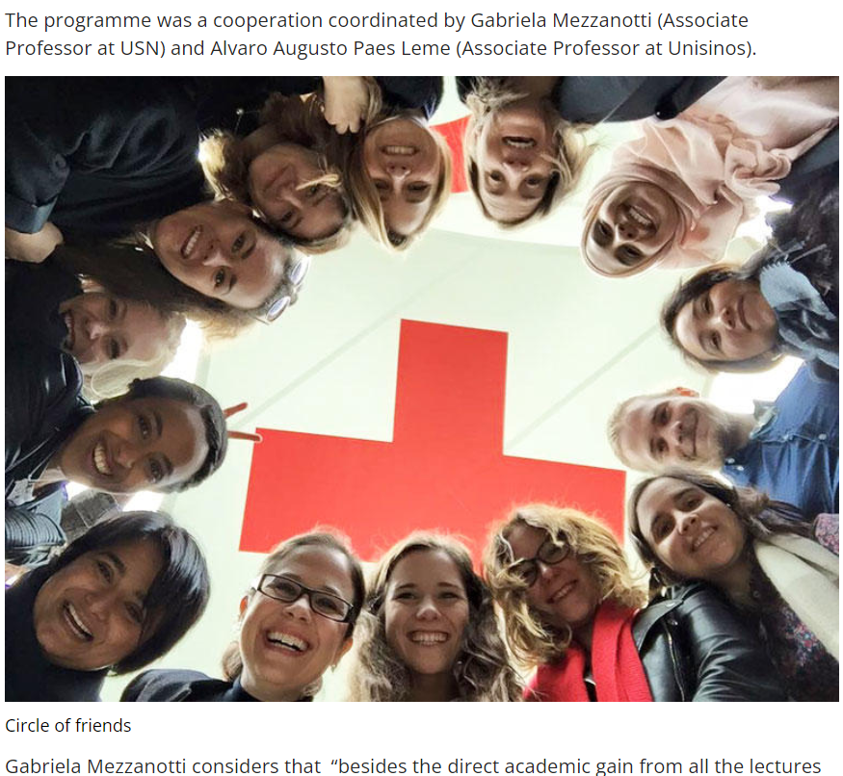
Geneva

Slide 9
Thank you! Tusen takk! Gabriela Mezzanotti. Associate Professor at USN - University of South-Eastern Norway – MSc in Human Rights and Multiculturalism www.usn.no Co-leader of the research group in Human Rights and Diversities Department of Culture, Religion and Social Sciences gabriela.mezzanotti@usn.no +47 41 31 25 07 https://www.usn.no/english/about/contact-us/employees/gabriela-mezzanotti Program coordinator: Åsne Håndlykken-Luz Asne.Handlykken-luz@usn.no 😊

